Slide 1
Roadmap for today
Forms of fossil fuels (coal, oil, gas)
How we make electricity from burning fossil fuels (or anything else)
What burning has to do with chemical bonds
How we refine the oil we extract from the ground (for burning, and also to make plastics)
How we extract fossil fuels from the ground

Slide 2
Fuel comparisons
Reports on these molecule comparisons:
2,2,4-Trimethylpentane vs n-octane
cyclooctane vs n-octane
ethanol vs methanol
ethanol vs propanol
glycerol vs 1,2-Propanediol
D-glucose vs fructose
2. I’ll report on these:
decanoic acid vs methyl decanoate
glycerol vs glyceryl tristearate
How are they similar/different?
Number of carbon atoms
H–to–C atom ratio
Straight or branched?

Slide 3
Fuel categories
Hydrocarbon
Alcohol
Sugar
Acid
Ester

Slide 4
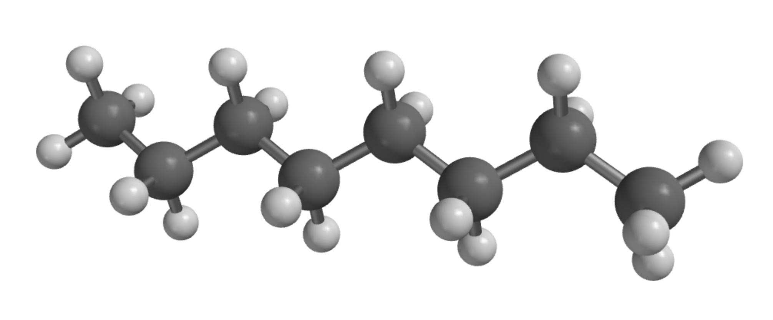
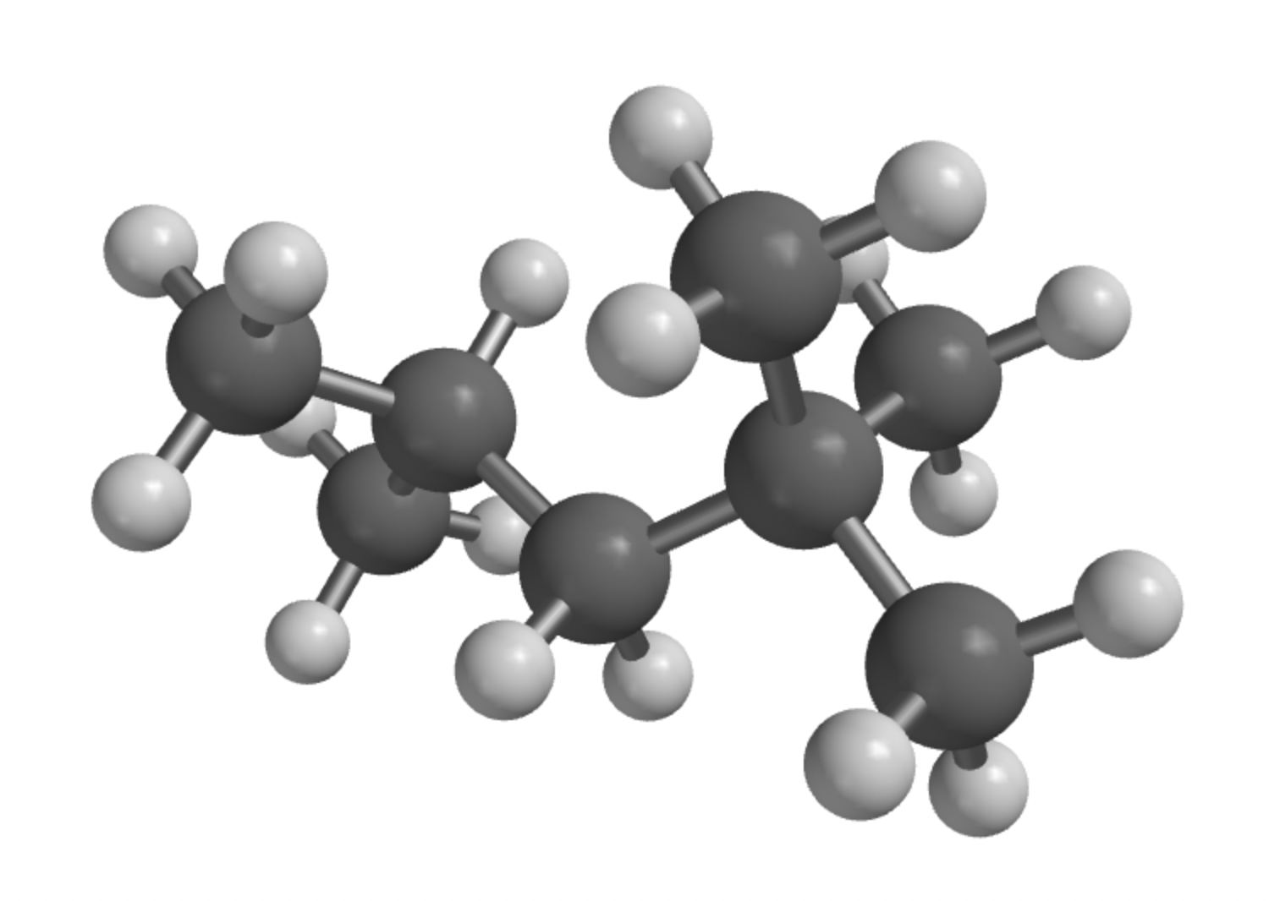
Fuel categories
Hydrocarbon
Alcohol
Sugar
Acid
Ester
n-octane
2,2,4-trimethylpentane
Only carbon and hydrogen
Can be linear (n-octane) or branched
Different volatilities (tendency to vaporize)

Slide 5
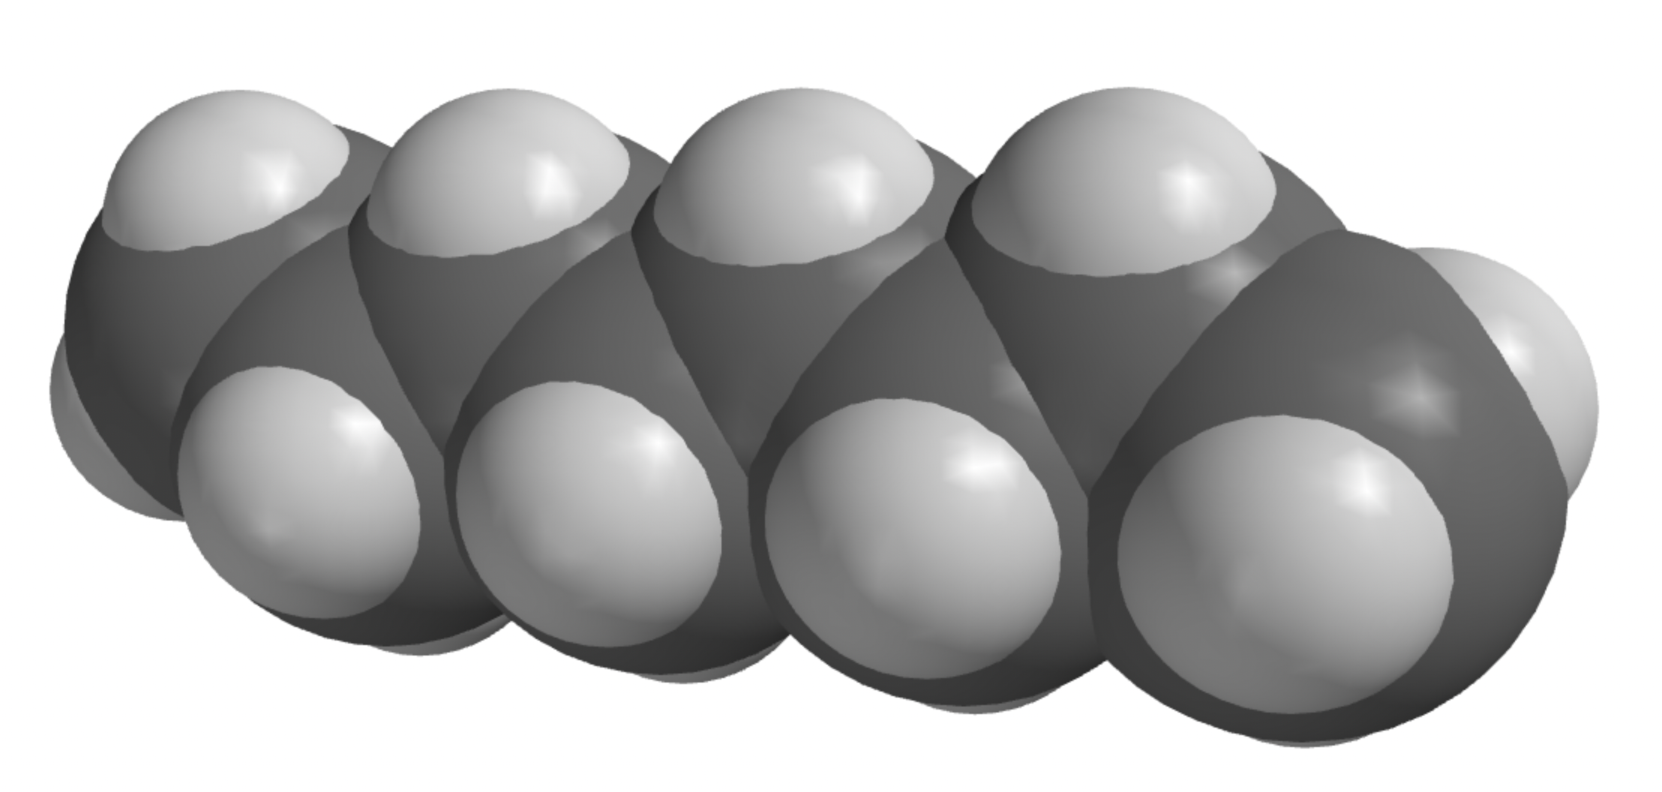
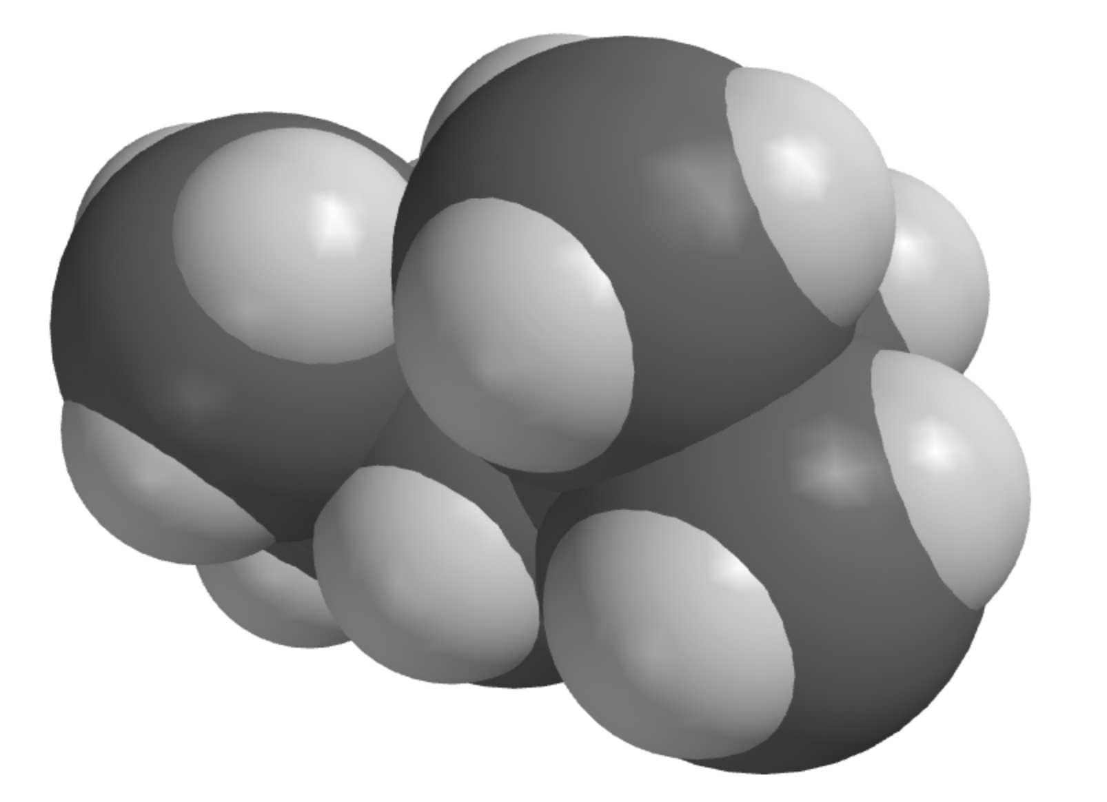
Fuel categories
Hydrocarbon
Alcohol
Sugar
Acid
Ester
n-octane
2,2,4-trimethylpentane
(iso-octane)
Only carbon and hydrogen
Can be linear (n-octane) or branched
Different volatilities (tendency to vaporize)

Slide 6
Fuel categories
Hydrocarbon
Alcohol
Sugar
Acid
Ester
n-octane
2,2,4-trimethylpentane
(iso-octane)
Which is more volatile? (boils more easily)
Only carbon and hydrogen
Can be linear (n-octane) or branched
Different volatilities (tendency to vaporize)

Slide 7
Fuel categories
Hydrocarbon
Alcohol
Sugar
Acid
Ester
n-octane
Boils at +126 ºC
2,2,4-trimethylpentane
(iso-octane)
Boils at +100 ºC
Which is more volatile? (boils more easily)
Only carbon and hydrogen
Can be linear (n-octane) or branched
Different volatilities (tendency to vaporize)

Slide 8
Fuel categories
Hydrocarbon
Alcohol
Sugar
Acid
Ester
n-octane
Boils at +126 ºC
2,2,4-trimethylpentane
(iso-octane)
Boils at +100 ºC
Which is more volatile? (boils more easily)
Only carbon and hydrogen
Can be linear (n-octane) or branched
Different volatilities (tendency to vaporize)

Slide 9
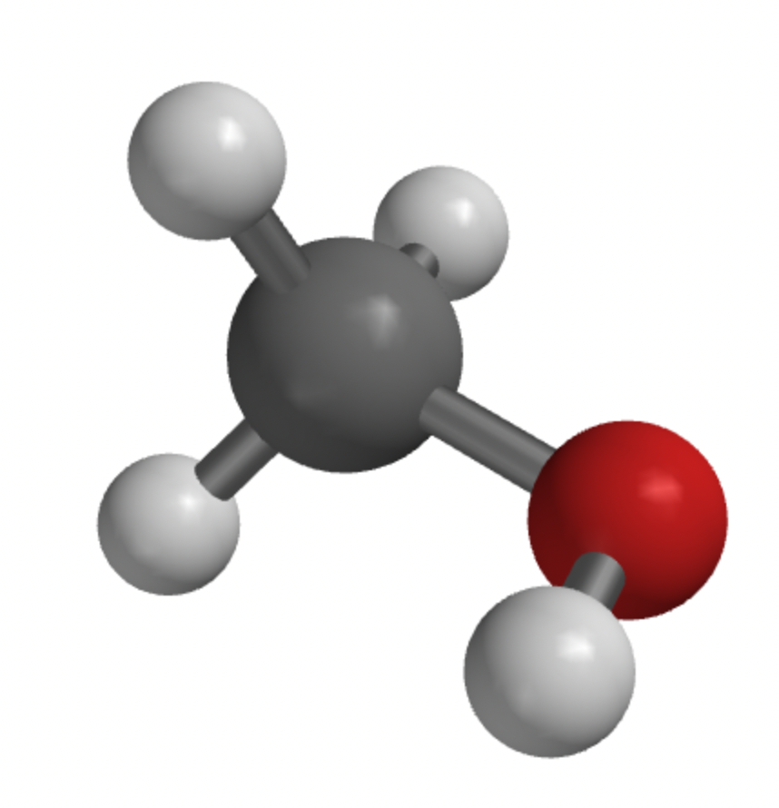
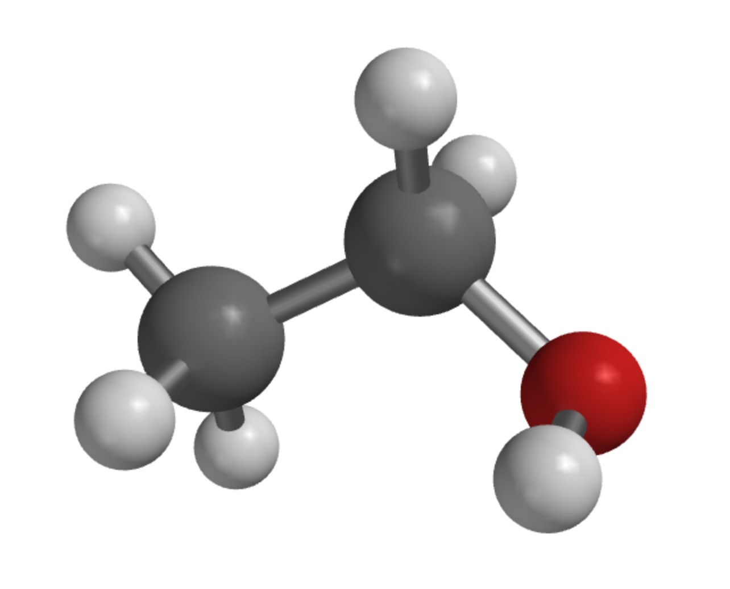
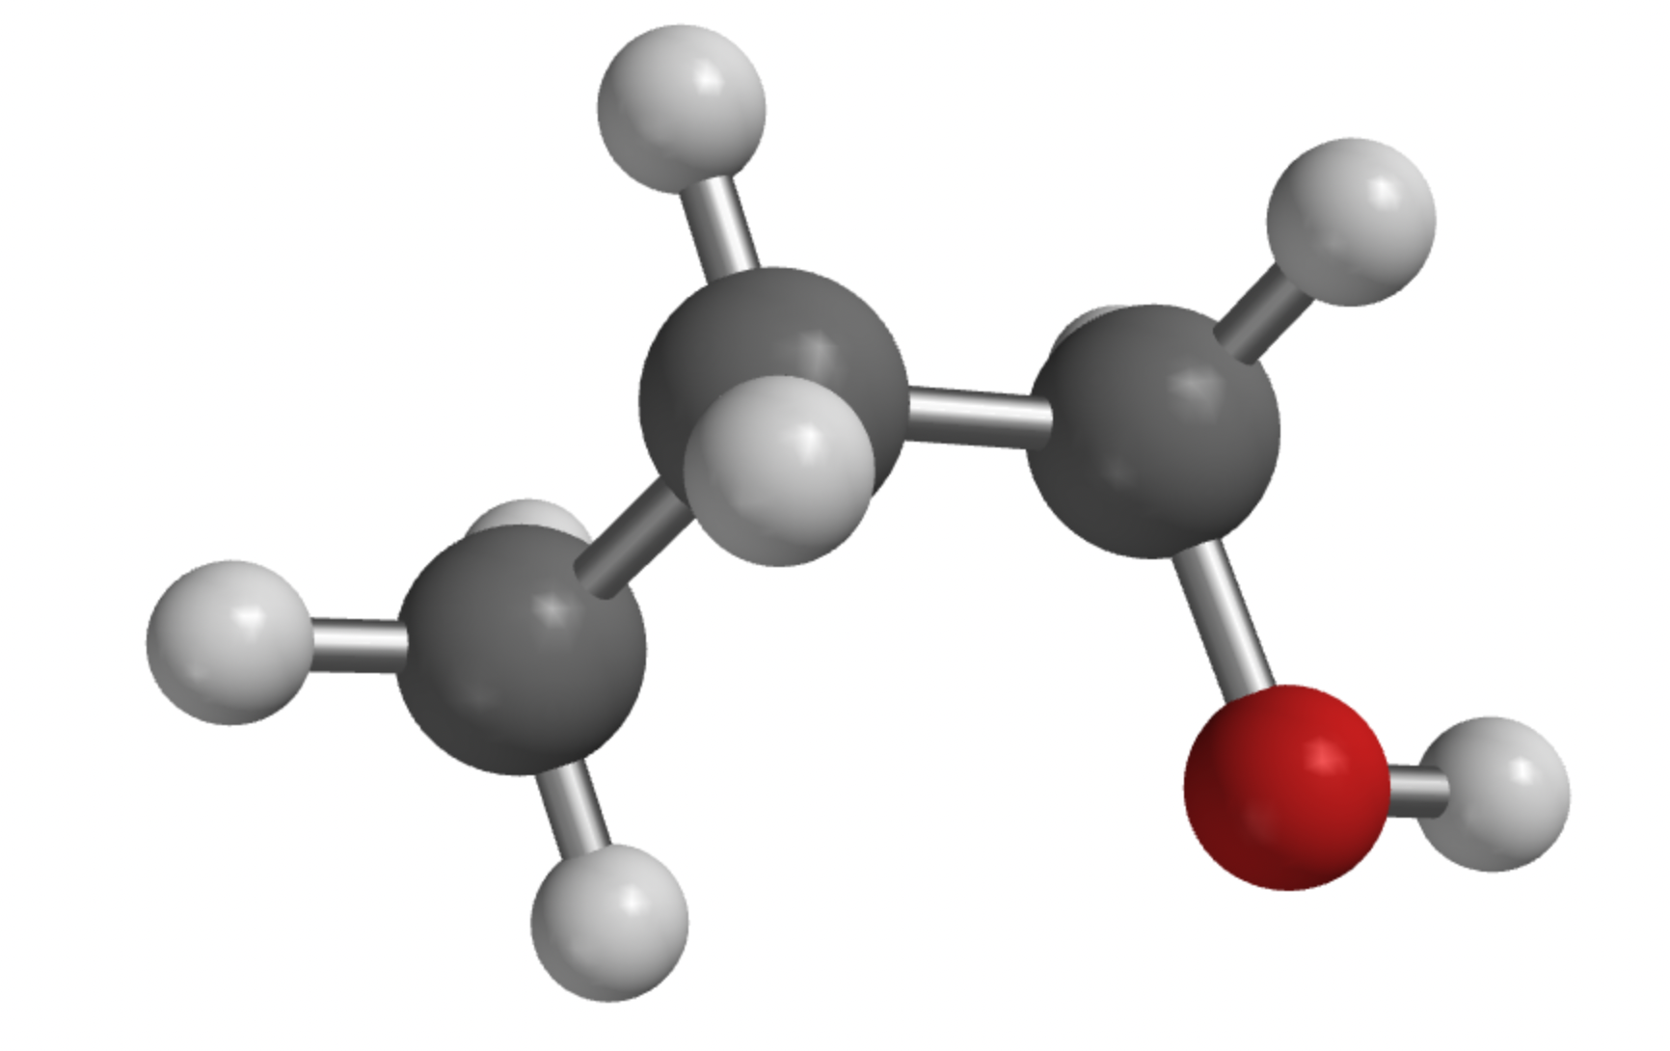
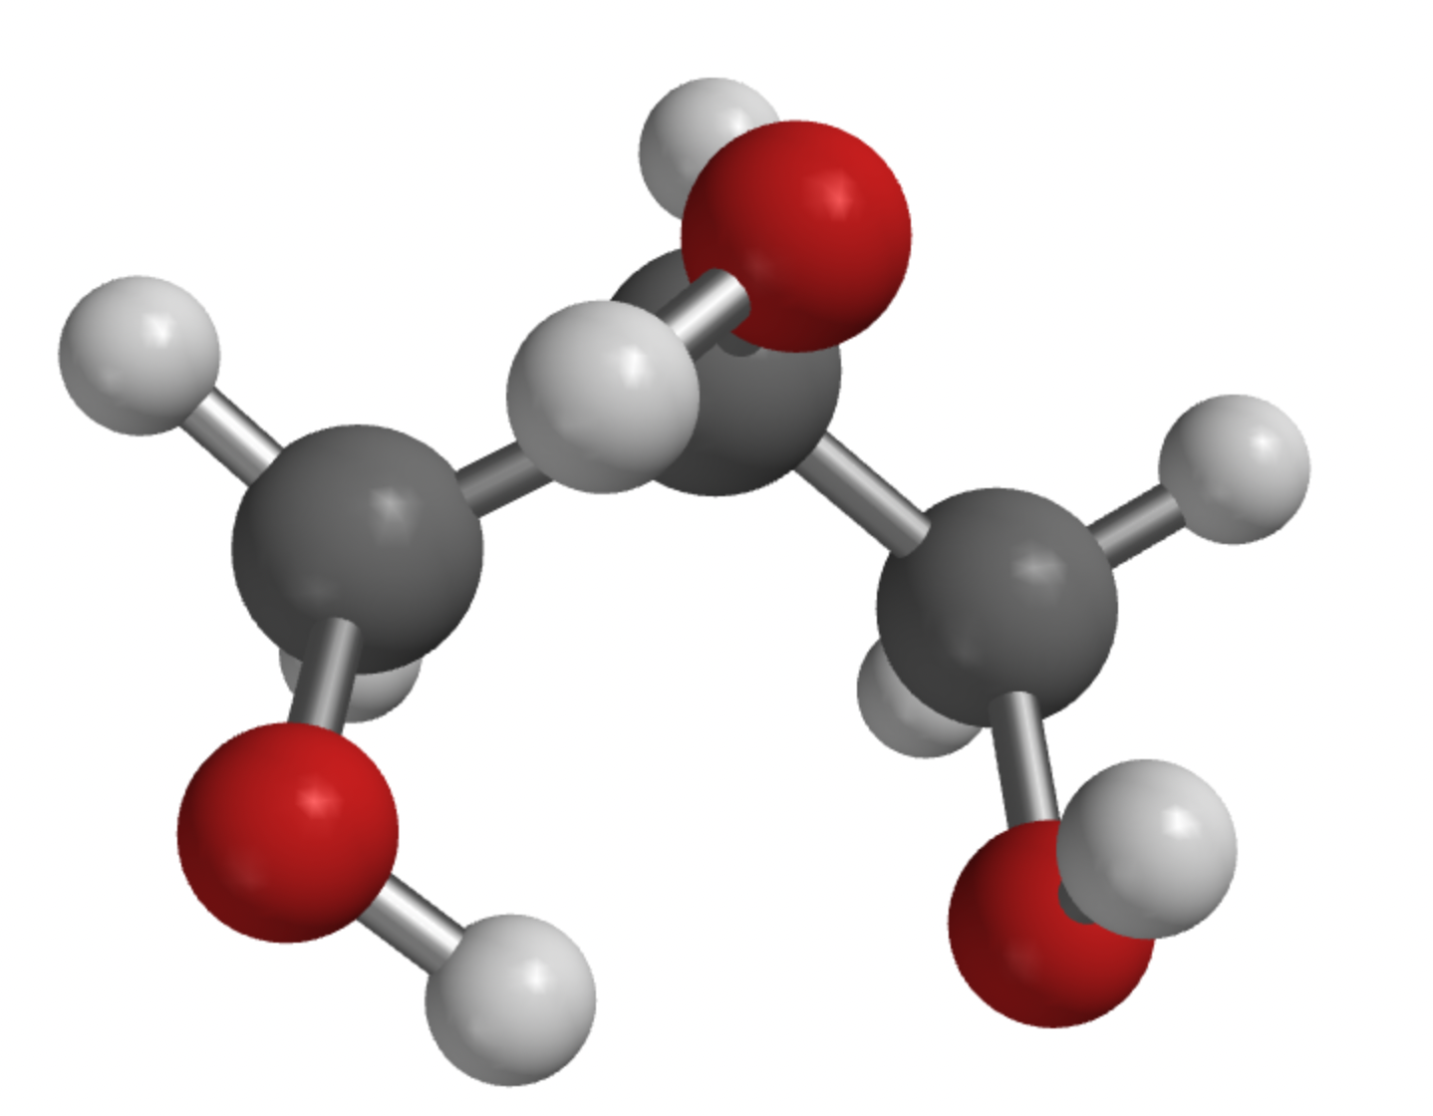
Fuel categories
Hydrocarbon
Alcohol
Sugar
Acid
Ester
Methanol
Ethanol
Glycerol
Propanol
Hydrocarbon and a C-OH group
OH group can be at multiple locations

Slide 10
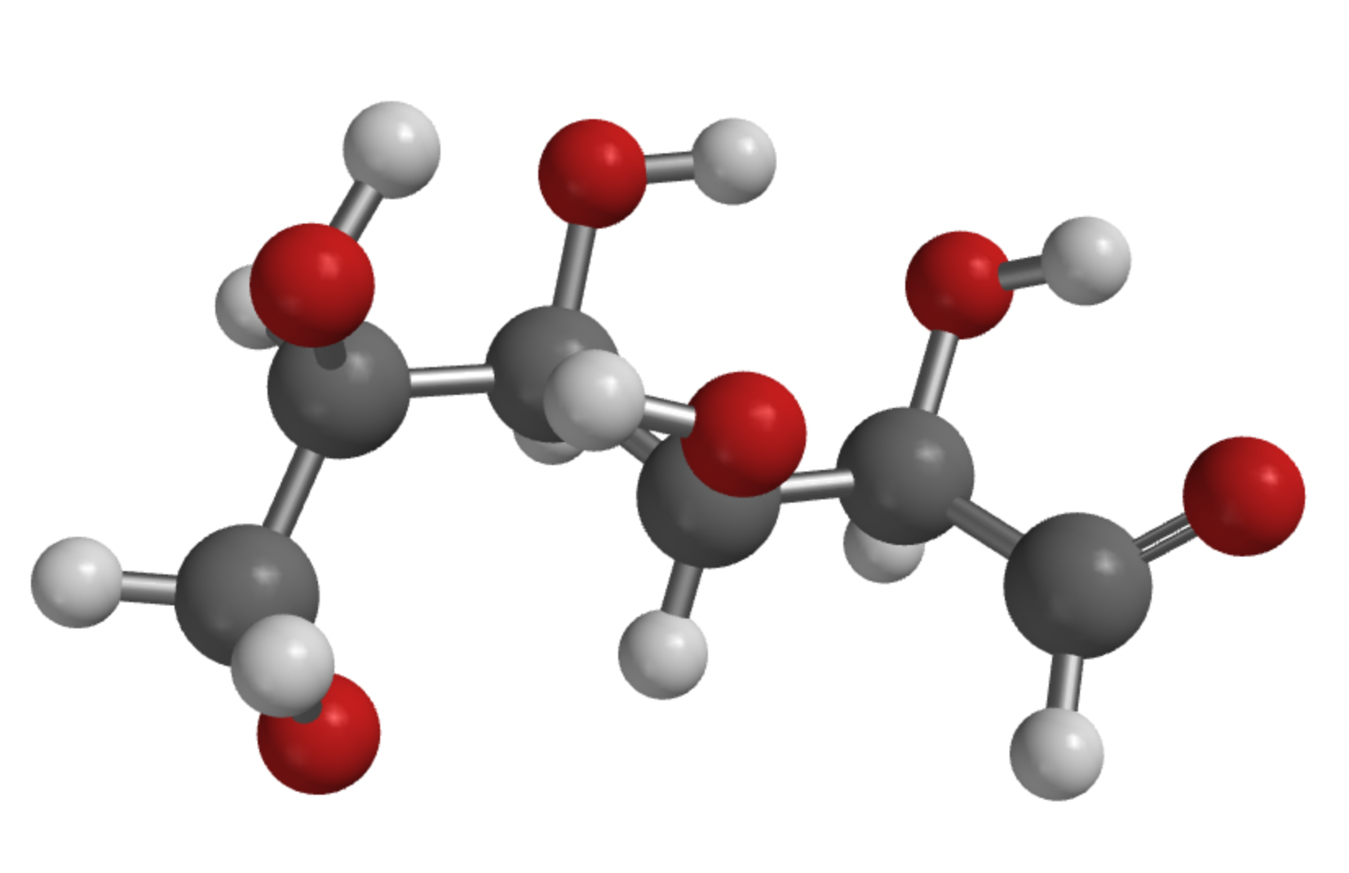
Fuel categories
Hydrocarbon
Alcohol
Sugar
Acid
Ester
Glucose
Hydrocarbon, C-OH groups, and a C=O group
Taste sweet, stored in plant tissue

Slide 11
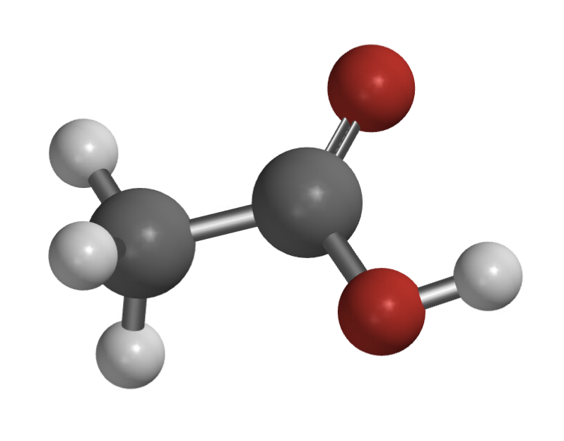
Fuel categories
Hydrocarbon
Alcohol
Sugar
Acid
Ester
Ethanoic acid
(active ingredient in vinegar, AKA acetic acid)
Hydrocarbon, with C-OH and C=O on the same carbon
Taste sour, stored in plant tissue

Slide 12
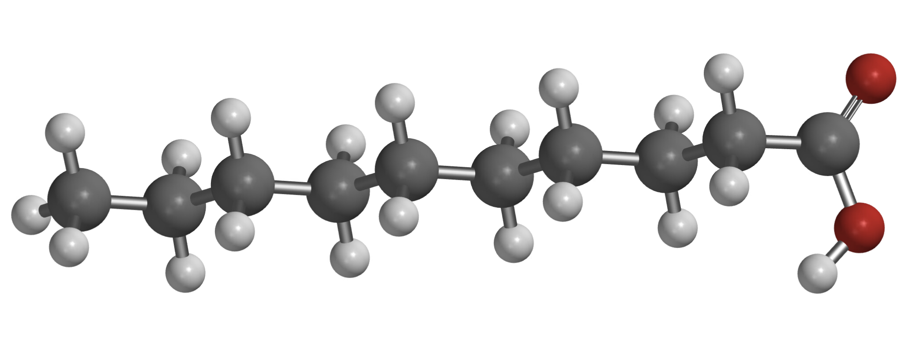
Fuel categories
Hydrocarbon
Alcohol
Sugar
Acid
Ester
Decanoic acid
Hydrocarbon, with C-OH and C=O on the same carbon
Taste sour, stored in plant tissue

Slide 13
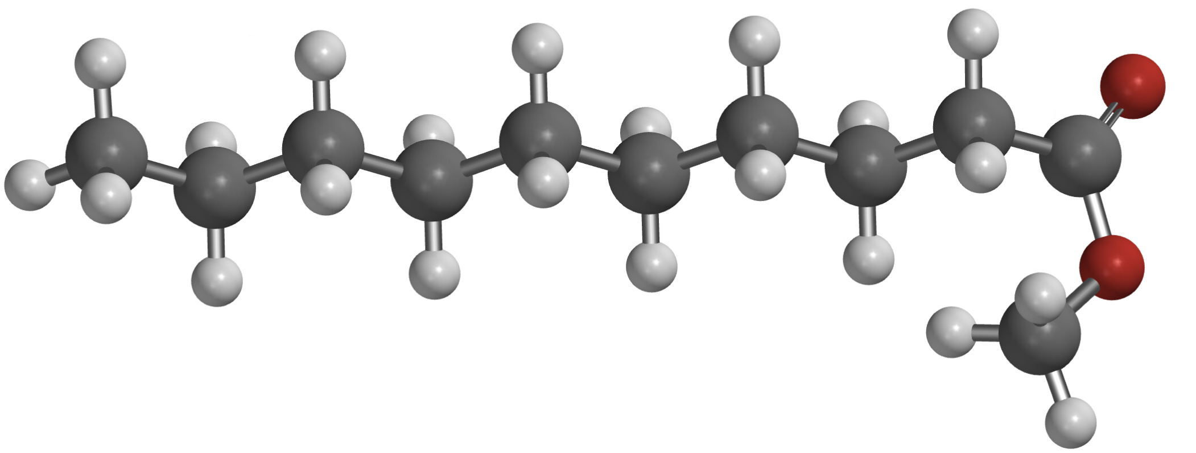
Fuel categories
Hydrocarbon
Alcohol
Sugar
Acid
Ester
Methyl decanoate
Like an acid, but with O-CH₃ instead of O-H
Smell sweet (flowers)

Slide 14
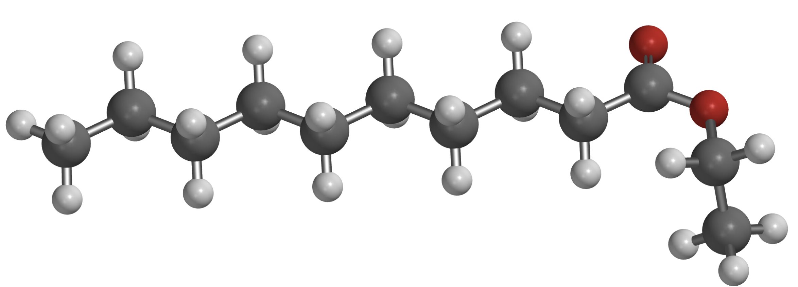
Fuel categories
Hydrocarbon
Alcohol
Sugar
Acid
Ester
Ethyl decanoate
Like an acid, but with O-CH₂CH₃ instead of O-H
Smell sweet (flowers)

Slide 15
Roadmap for today
Forms of fossil fuels (coal, oil, gas)
How we make electricity from burning fossil fuels (or anything else)
What burning has to do with chemical bonds
How we refine the oil we extract from the ground (for burning, and also to make plastics)
How we extract fossil fuels from the ground

Slide 16
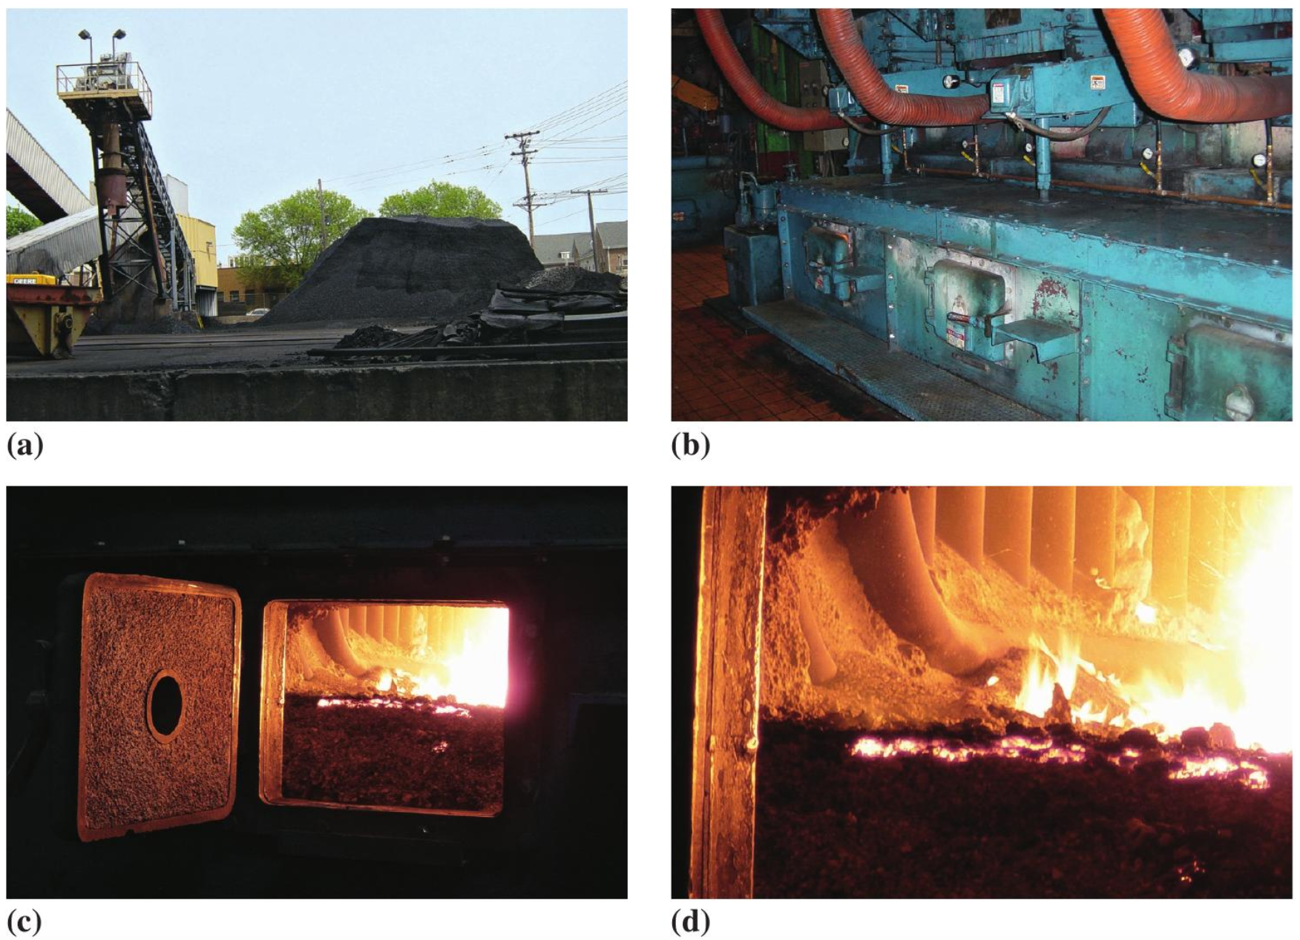
Architecture of a coal-fired electric power plant

Slide 17
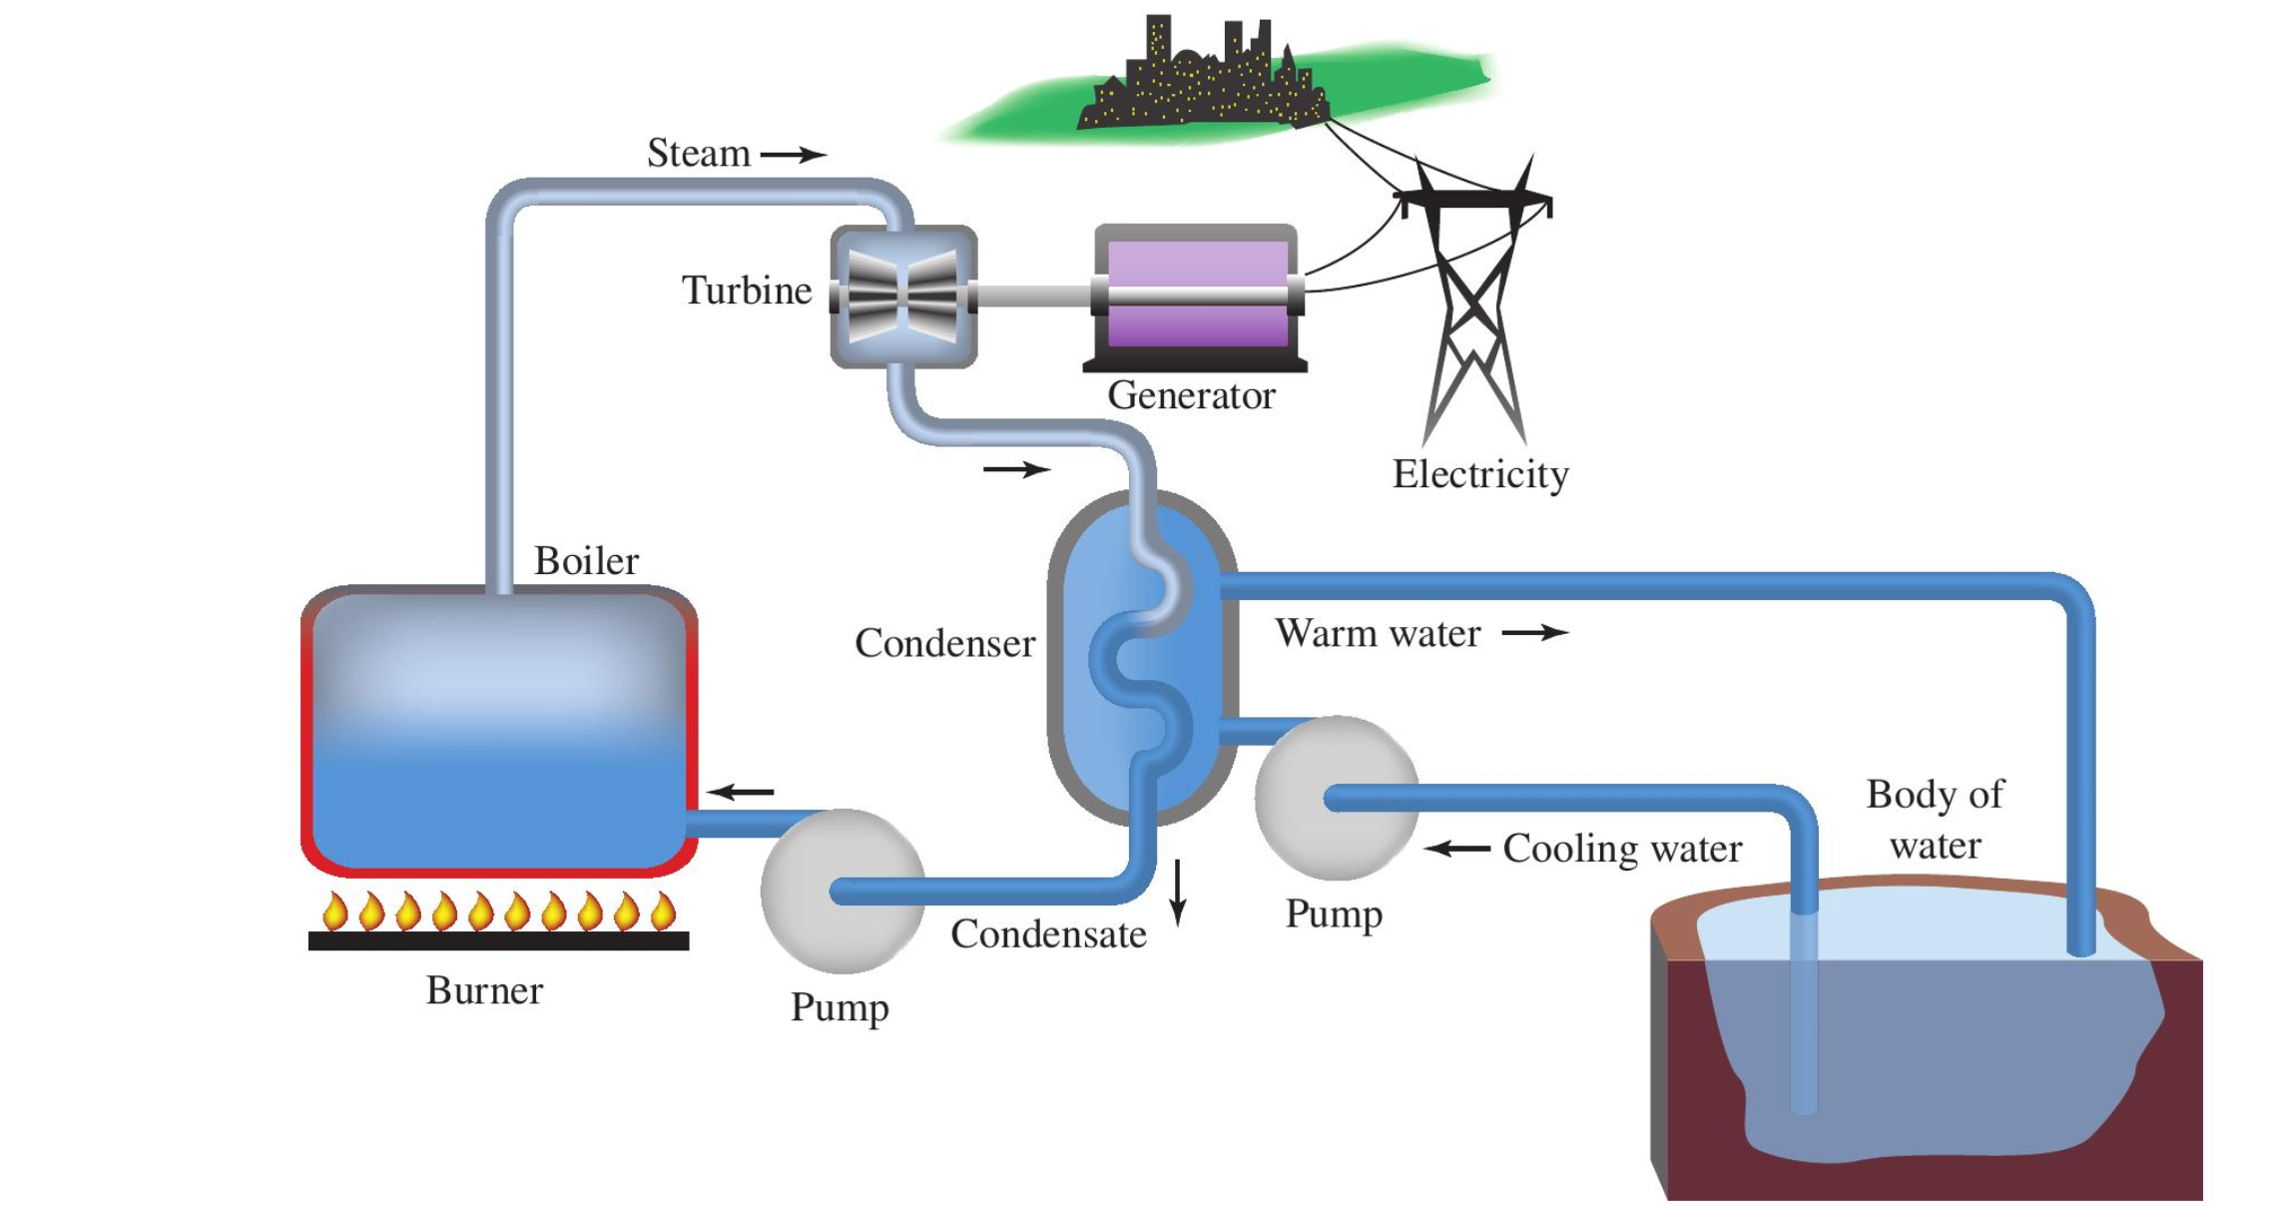
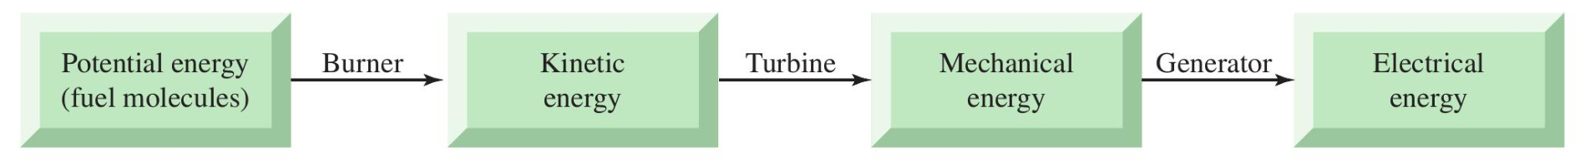
Architecture of a coal-fired electric power plant

Slide 18
The generality of an electric power plant
Heating by
Burning coal/oil/gas, or
Controlled fission of nuclear “fuels,” or
Concentrating solar energy with mirrors

Slide 19
Roadmap for today
Forms of fossil fuels (coal, oil, gas)
How we make electricity from burning fossil fuels (or anything else)
What burning has to do with chemical bonds
How we refine the oil we extract from the ground (for burning, and also to make plastics)
How we extract fossil fuels from the ground

Slide 20
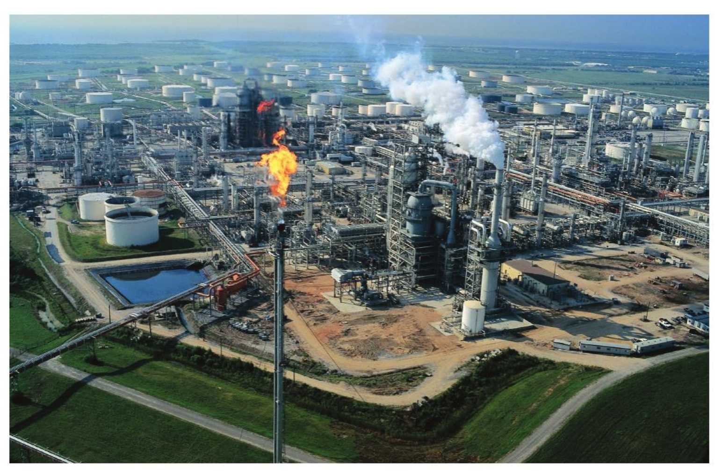
Refining of crude oil

Slide 21
Crude oil comes in …

Slide 22
.. and is refined in distillation towers

Slide 23
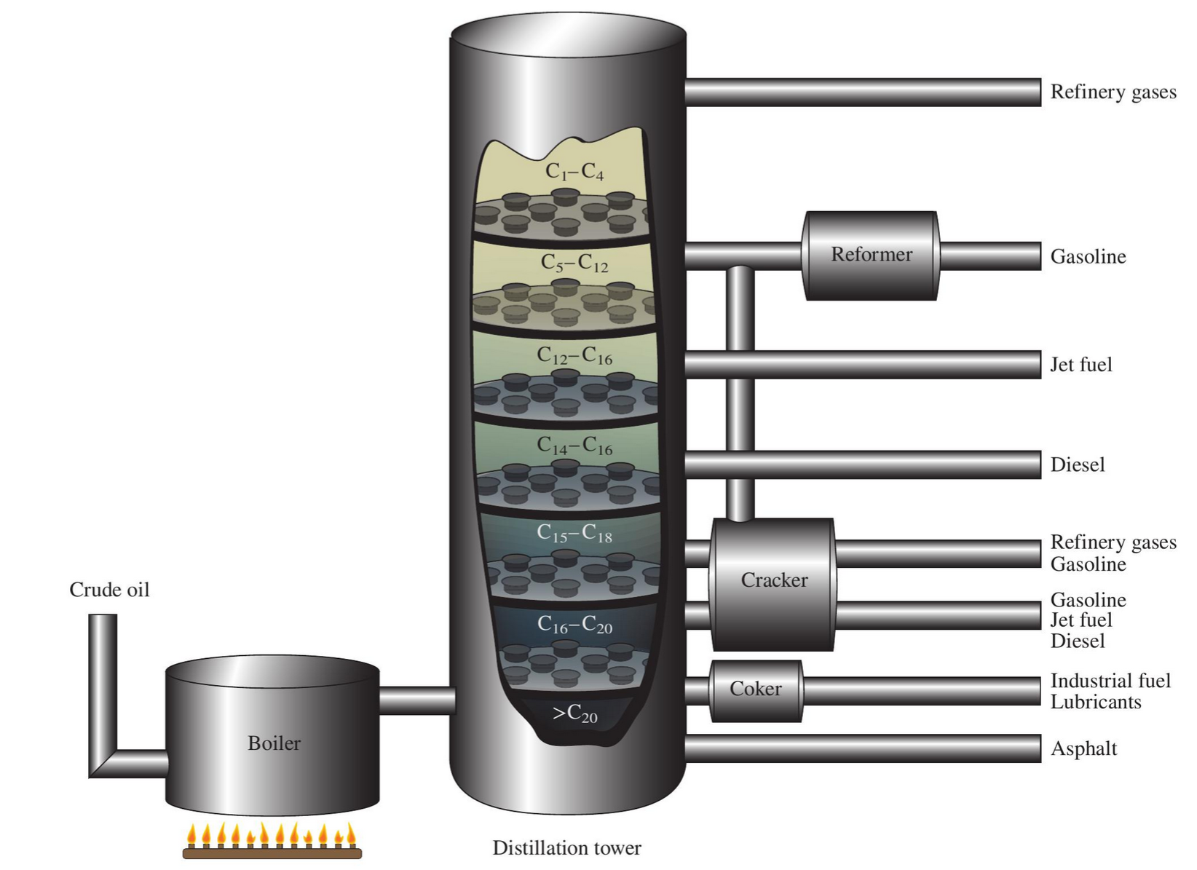
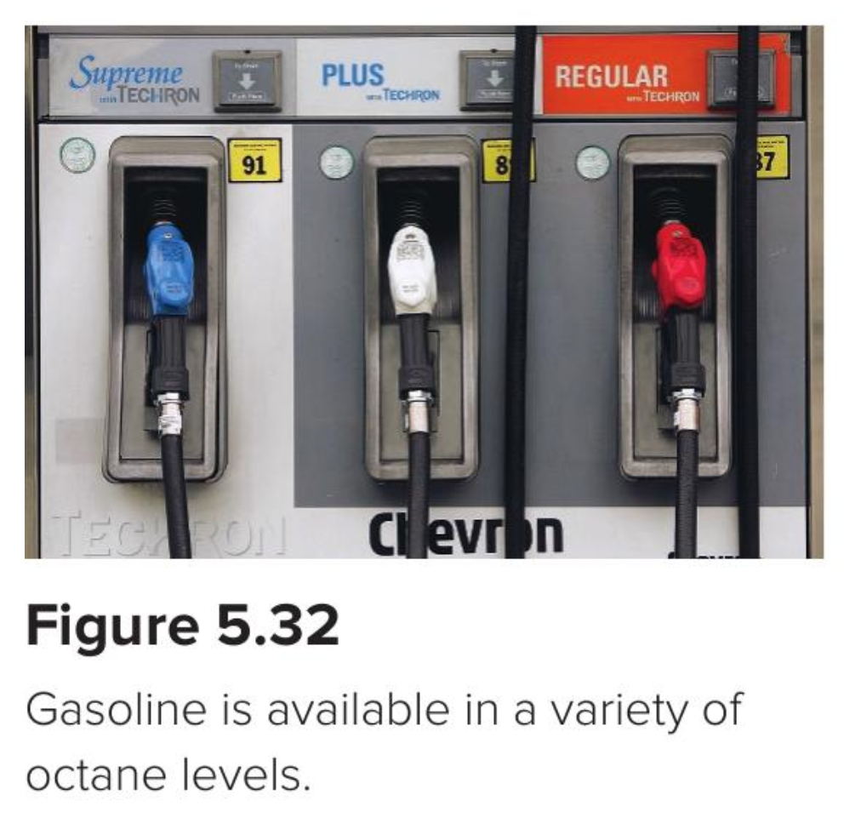
What’s distillation?
More volatile components rise higher

Slide 24
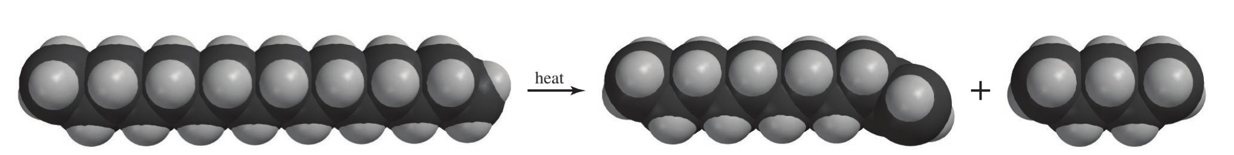
We can even bust up (“crack”) longer hydrocarbons to make them more useful

